Slide 1

Security System Project (Embedded Systems – CIE 408) Dr. Ahmed Sayed
Belal Gamal -202101237
Abd Alrhman Ahmed - 202101112
Marwan Ahmed - 202101214
Yousef Khaled – 202100191
Mohamed Hosam - 202100975

Slide 2
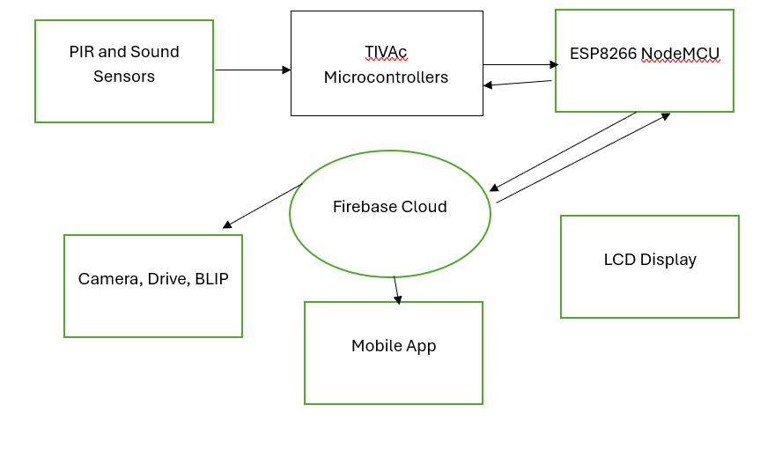
Block Diagram

Slide 3
Components
Tiva C Series Microcontroller (TM4C123G) | Borrow from the lab
ESP8266 NodeMCU | 180 LE
PIR Motion Sensor | 60 LE
Sound Sensor Module | 65 LE
LCD Display (16x2 with I2C adapter) | 95 LE
5V Power Adapter (1A-2A output) | 70 LE
LEDs & Buzzer | 35 LE
Breadboard & Jumper Wires | 25 LE
Resistors & Capacitors | 15 LE

Slide 4
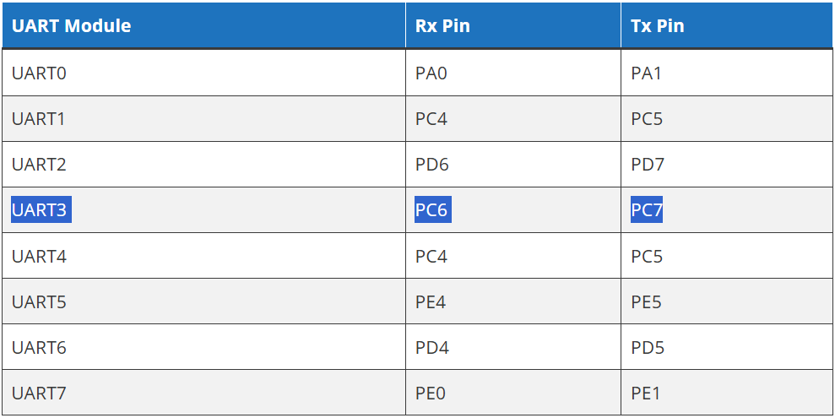
UART com.

Slide 5
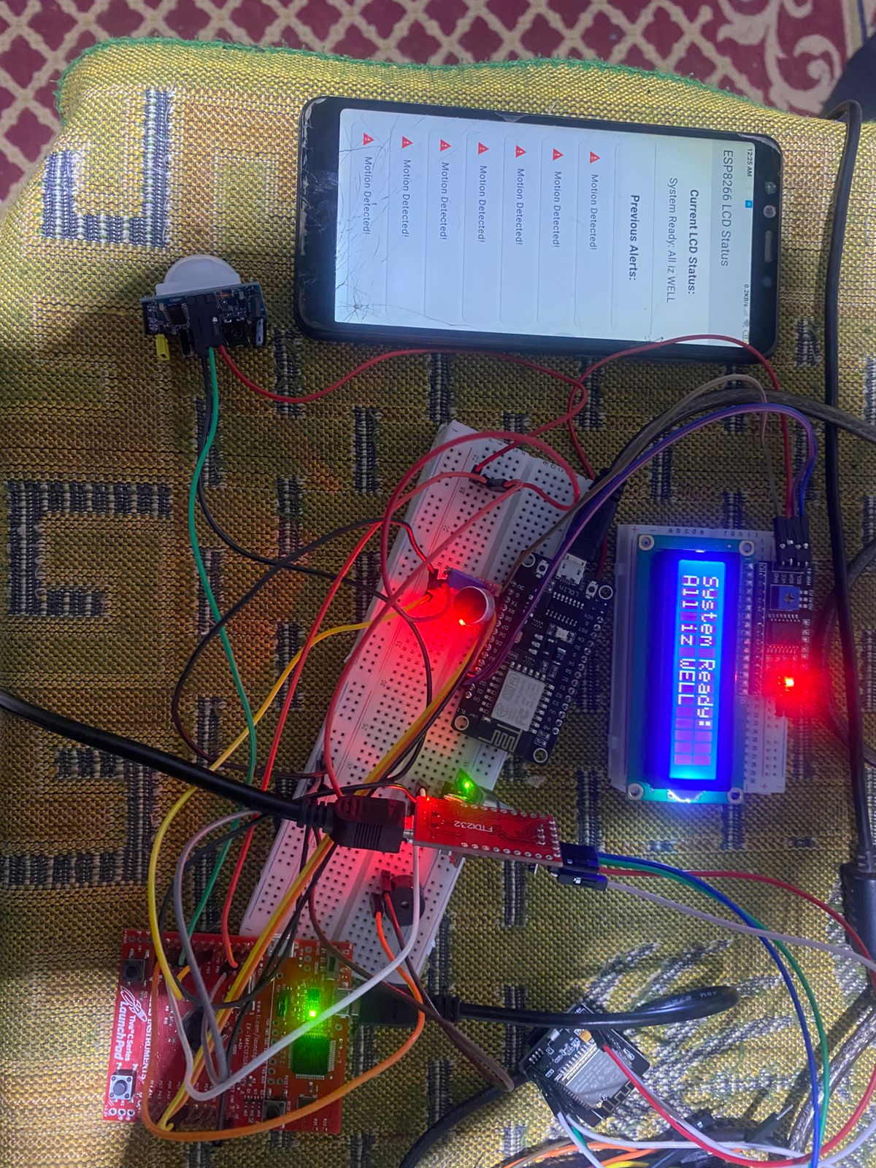
Hardware

Slide 6
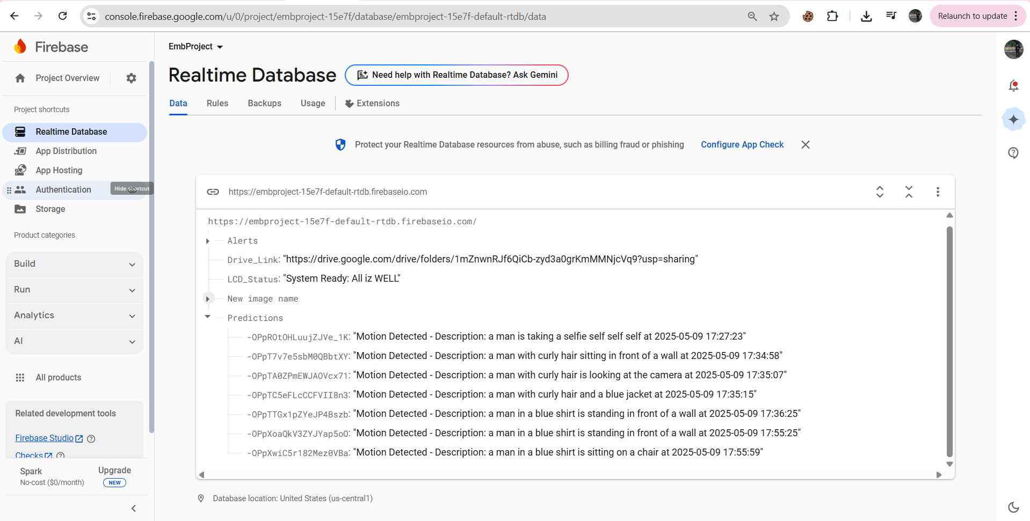
FireBase

Slide 7
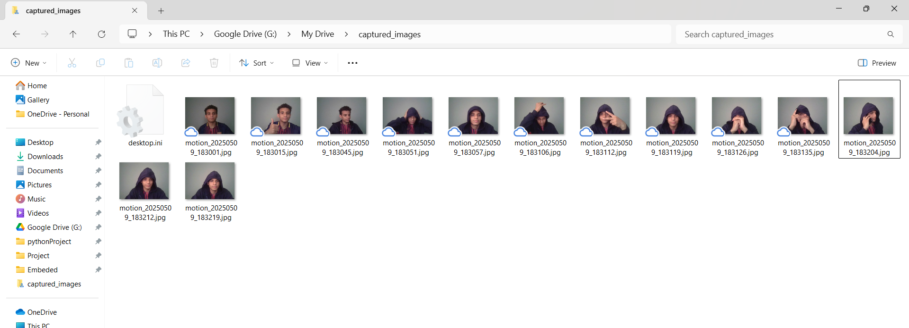
images

Slide 8
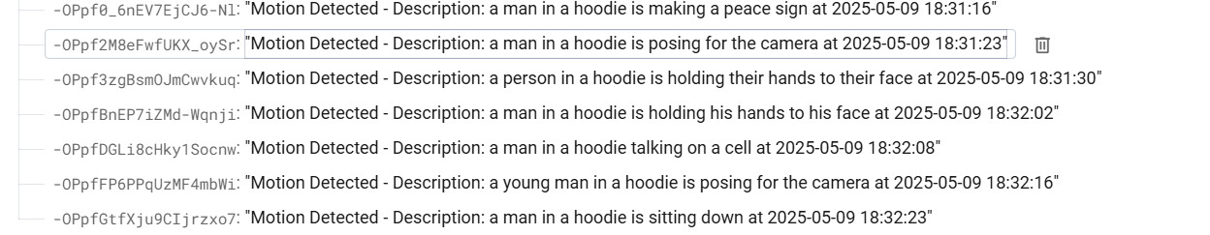
BLIP predictions

Slide 9
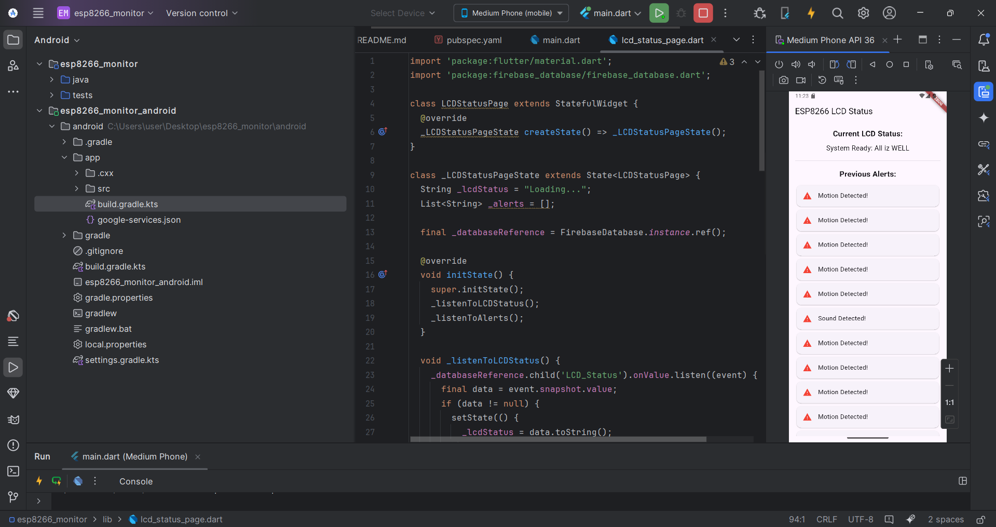
Mobile App (flutter)

Slide 10
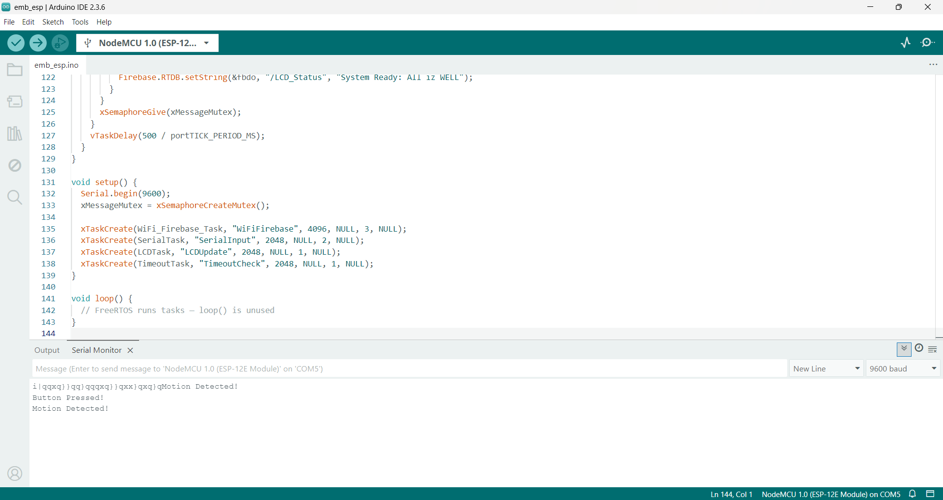
ESP code (freertos)

Slide 11
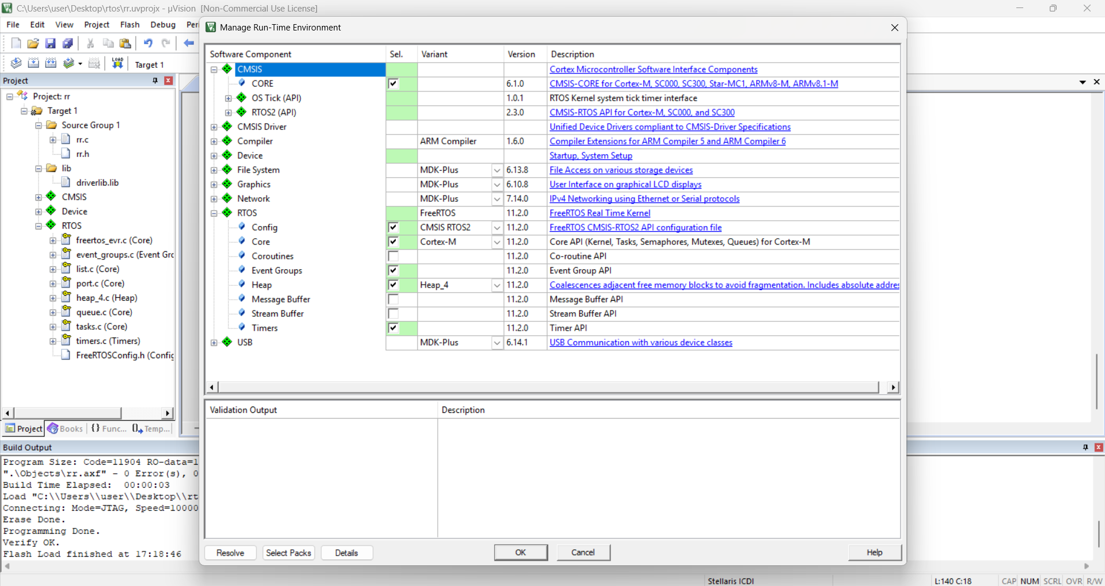
FreeRtos init

Slide 12
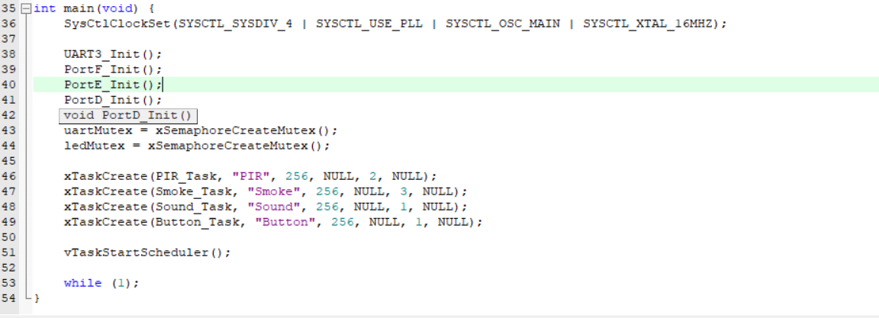
Main()

Slide 13
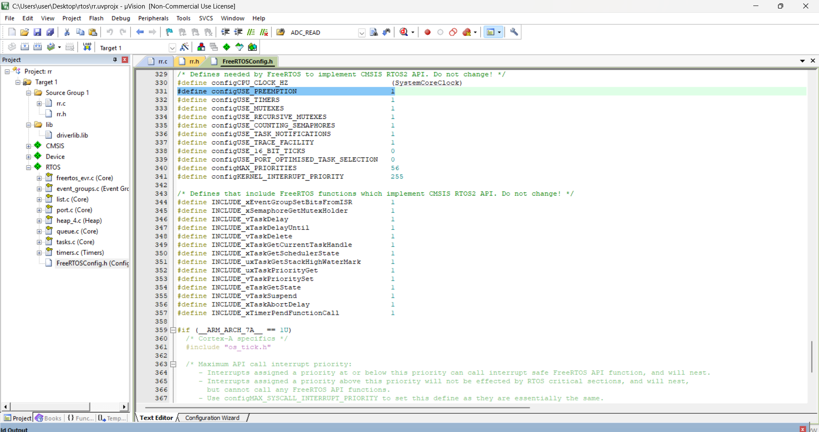
Using Preemptive scheduling

Slide 14
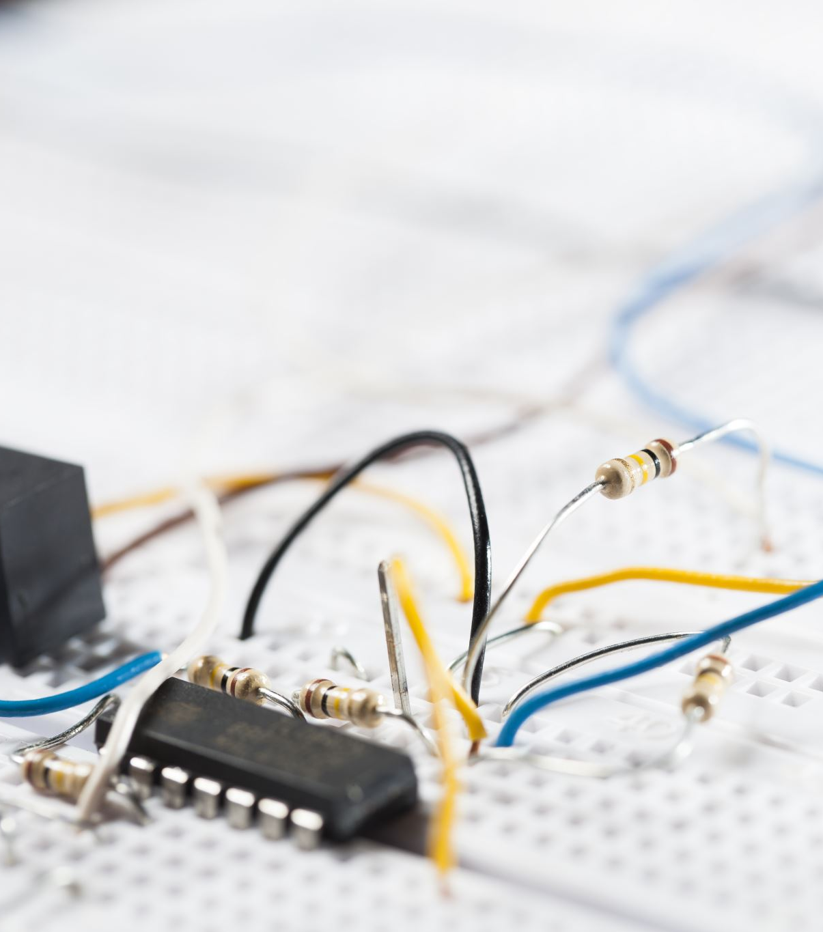
Freertos logic
Smoke Task (priority 3) preempts others.
PIR Task (priority 2) is next in priority.
Sound and Button Tasks (priority 1) share CPU time when higher-priority tasks are idle/delayed.
UART access is mutex-protected to avoid overlapping UART writes.

Slide 15
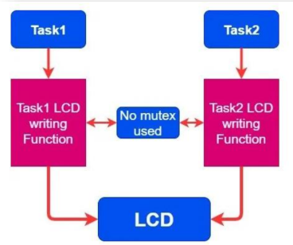
Mutex

Slide 16
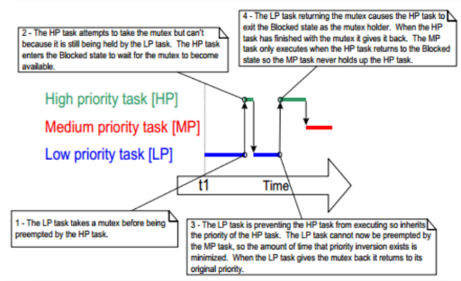
MUTEX

Slide 17
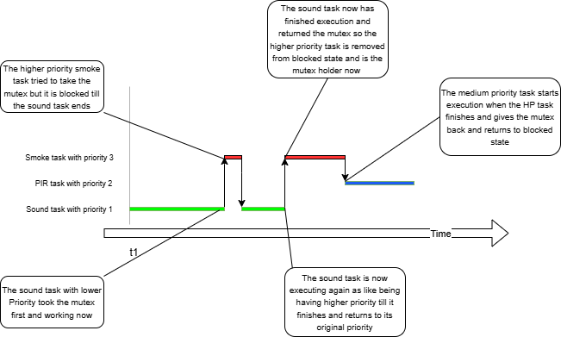
MUTEX

Slide 18
Running time
Task | Scheduled Start Times (ms) | Execution Time (ms) | Delay Between Runs (ms) | vTaskDelay Equivalent
Smoke_Task | 0, 200, 400 | 50 | 200 | vTaskDelay(pdMS_TO_TICKS(200))
PIR_Task | 50, 250, 450 | 50 | 200 | vTaskDelay(pdMS_TO_TICKS(200))
Sound_Task | 100, 300 | 50 | 200 | vTaskDelay(pdMS_TO_TICKS(200))

Slide 19
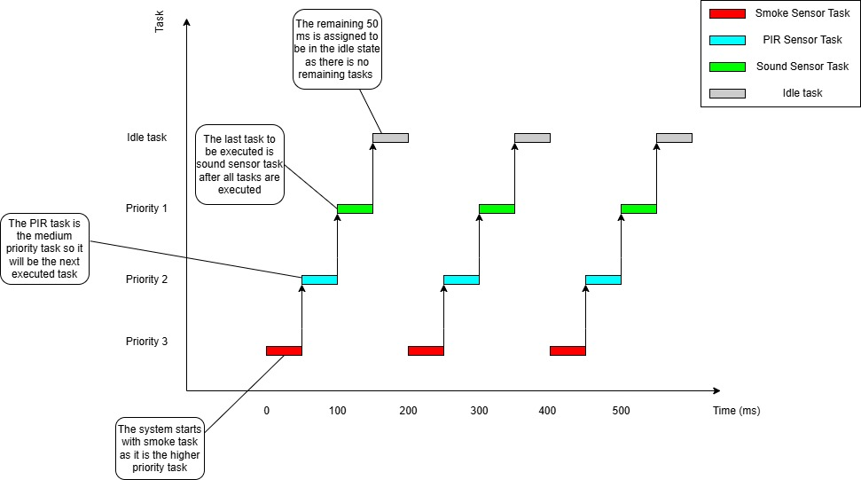

Slide 20

Mutex Use: Only one task prints via UART3 at a time. Prevents overlapping strings, garbled output, and bus conflict.

Slide 21

Thanks

